Slide 1
Introduction to Performance Engineering and Performance Center Northeastern University INFO6255

Slide 2
Performance Engineering
Can I deploy my application to other regions?
How much hardware do I need?
Why is my application slow sometimes?
Why is my application intermittent?
How many more users can I support?
Can my application support X users and maintain a X second response time?
If I patch the OS, am I risking performance?
My application is fast…but I have to reboot it periodically!
What is the variance of my application’s performance?

Slide 3
Performance Engineering
How can we answer all those
questions?

Slide 4
Performance Engineering
Definition
“Performance engineering within systems engineering, encompasses the set of roles, skills, activities, practices, tools,
and deliverables applied at every phase of the SDLC which ensures that a solution will be designed, implemented, and operationally supported to meet the non-functional performance requirements defined for the solution.”
Source: Wikipedia

Slide 5
Performance Engineering
Questions
What do you want to learn from your system?
How fast is it?
How does it scale?
Where does it break?
What do you want to prove about your system?
Response times are X.
Throughput is Y.
Scales Up to # of Z users.

Slide 6

Performance Engineering
Activities
Capacity and Performance Modeling
Production Support
Infrastructure Tuning
Performance Engineering
System Validation Testing
Benchmarking
Unit / Component Performance Testing
Code Profiling and Optimization

Slide 7
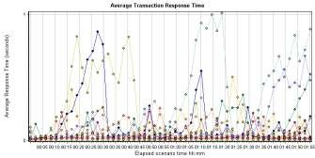
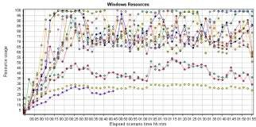
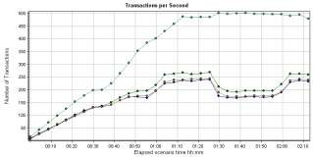
Performance Engineering
Key Performance Indicators
Responsiveness
Throughput
Stability
Scalability

Slide 8
Why Performance Testing? Case Studies From 2014
Lloyds Bank’s ATMs unable to do transactions for 3 hrs.
RBS paid $175 million to its customer for IT failures apart from fines.
HealthCare.gov couldn’t handle the traffic when rolled out.
Facebook unavailable for 15 mins because of infrastructure configuration issues.
LinkedIn, Apple iTunes Store, Mac App Store, and App Store cannot go down.

Slide 9
System Performance Facts and Stats:
73% of mobile internet users say that they’ve encountered a website that was too slow to load.
51% of mobile internet users say that they’ve encountered a website that crashed, froze, or received an error.
38% of mobile internet users say that they’ve encountered a website that wasn’t available.
47% of consumers expect a web page to load in 2 seconds or less.
40% of users abandon a website that takes more than 3 seconds to load.
If an e-commerce site is making $100,000 per day, a 1 second page delay could potentially cost you $2.5 million in lost sales every year.
NeilPatel.com

Slide 10



Typical Application Architecture
Browser
Load Balancer
App Servers
Middleware/ Mid Tier
Database

Slide 11
Web Server Metrics
Busy and Idle Threads
Worker threads per web server
Number of web servers
Long running threads because of application performance hotspots
Throughput
Number of transactions / minute
When do we need to scale out and add more web servers?
Bandwidth Requirements
Network bottlenecks
Average page size

Slide 12
App Server Metrics
Load Distribution
Transactions are handled by each JVM engine
Load balancing
Number of Application Servers needed to handle the load
CPU Hotspots
CPU requirements
Parts of programming causing high CPU requirement
CPU power

Slide 13
App Server Metrics
Worker Threads
Number of worker threads configured
Threads blocked by other modules
Memory Issues
Bad memory patterns
Memory leaks
Impact of Garbage Collection on CPU and Transaction Throughput

Slide 14
Host Health Metrics
CPU, Memory, Disk, I/O
Physical or virtual resources health
Log files
Network interfaces
Key Processes
Processes run on the host
Resource hungry processes
Management of processes

Slide 15
Performance Engineering
Types of Tests
Performance testing - Determines or validates the speed, scalability, and/or stability characteristics of the system or application under test. It is intended to determine the
Responsiveness
Throughput
Reliability
Scalability
of a system under a given workload
Load Testing is asserting how the architecture performs under load with a view to monitoring the response times for key transactions. (Anticipated volumes)

Slide 16
Performance Engineering
Types of Tests
Stress Testing is asserting what the upper bounds are for the scalability of the architecture, understanding how it reacts when stressed. (Beyond Anticipated volumes).
Capacity Testing is to determine how many users and/or transactions a given system will support and still meet the performance goals
To identify a scaling strategy.

Slide 17
Assess production readiness
Predict or estimate the performance characteristics of an application in production and evaluate whether or not to address performance concerns based on those predictions.
These predictions are also valuable to the stakeholders who make decisions about
application is ready for release or capable of handling future growth
it requires a performance improvement/hardware upgrade prior to release.
Providing data
Indicating the likelihood of user dissatisfaction with the performance characteristics of the system.
To aid in the prediction of revenue losses or damaged brand credibility due to scalability or stability issues, or due to users being dissatisfied with application response time.

Slide 18
Assess infrastructure requirement
Evaluating the adequacy of current capacity.
Determining the acceptability of stability.
Determining the capacity of the application’s infrastructure, as well as determining the future resources required to deliver acceptable application performance.
Comparing different system configurations to determine which works best for both the application and the business.
Verifying that the application exhibits the desired performance characteristics, within budgeted resource utilization constraints.

Slide 19
Improve the efficiency of performance tuning
Analyzing the behavior of the application at various load levels.
Identifying bottlenecks in the application.
Providing information related to the speed, scalability, and stability of a product prior to production release, thus enabling you to make informed decisions about whether and when to tune the system.

Slide 20
What is a Baseline?
A baseline is a set of tests that capture the Performance Metrics for the purpose of evaluating the effectiveness of subsequent performance-improving changes to a system or an application.
Baseline can set the standard for comparison to track future optimization or regression.
Baseline can help identify changes in performance
Baseline metrics are articulated by using a broad set of Key Performance Indicators, including
Response time
Processor Capacity
Mem Usage
Disk Capacity
Network Bandwidth

Slide 21
What is a Benchmark?
Benchmarking is the process of comparing your system’s performance against a baseline that you have created internally or against an industry standard endorsed by some other organization
Benchmark is achieved by working with Industry Specifications or by porting an existing implementation to meet the standards
The Benchmarking results can be published to the outside world.
Many useful metrics can be shared or communicated:
Load Time
# of transactions processed
Web Pages accessed
Processor Usage
Memory Usage
Search Times

Slide 22
Performance Engineering
Methodology
Execute and Collect Metrics
Analyze Results
Prepare Tests

Slide 23
Performance Engineering
Tools
You will need tools to provide a meaningful performance assessment.
Even a simple stopwatch test will require a stopwatch.
The more complex your tests get, the better tools you will need to support them.

Slide 24
Performance Engineering
Tools
Open Source
JMeter, Grinder, openSTA, loadUI
Commercial
Silk Performer, VSTS, LoadRunner, Performance Center

Slide 25
Performance Center
“MicroFocus Performance Center is a suite of integrated performance testing solutions that can emulate hundreds or thousands of concurrent users to apply production workloads to virtually any environment; identify potential performance bottlenecks; and help diagnose and fix the root cause of the problems.”
Source: Performance Center Brochure

Slide 26
Performance Center
LoadRunner
Standalone set of tools to prepare, execute and analyze performance tests
Supports a wide variety of protocols
Can collect metrics from a wide variety of systems
Performance Center
Centralized test environment
Web interface
Leverages capabilities of LoadRunner

Slide 27
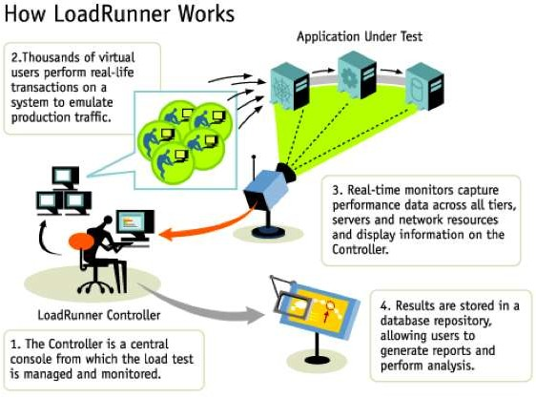
Performance Center

Slide 28
Performance Center
Protocols
HTTP, WebService, FTP, RMI, LDAP, Citrix, MQ, Ajax ...
SQL Server, Oracle ...
Oracle EBS, SAP, Siebel, PeopleSoft ...
Monitors
Windows, Unix ...
WebLogic, IIS, Apache, SiteScope ...
Scripting Language
C, Java

Slide 29
Performance Center
Centralized repository
Scripts, test scenarios, results and reports
Versioning (new on PC 11)
Dedicated resource pools
Load generators and controllers
User management
Integrate with AD and LDAP
Organized by domain and project
Usage limits can be applied per project

Slide 30
Performance Center
Web interface
Create test scenarios
Setup system probes
Execute and monitor tests
View reports
Desktop clients
Connect to Performance Center server
Script development (VuGen)
Analysis

Slide 31
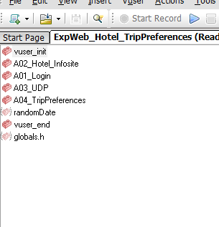
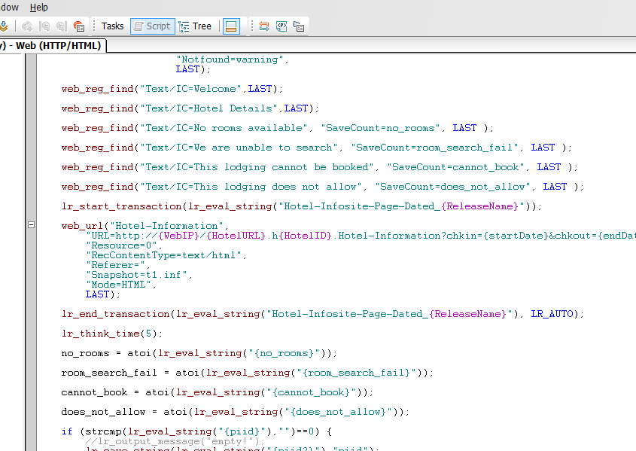
VuGen

Slide 32
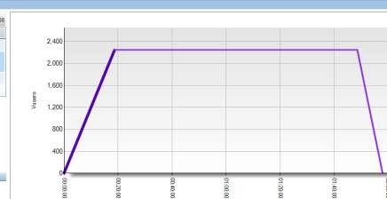
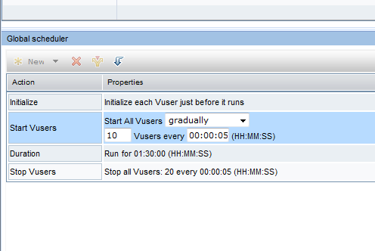
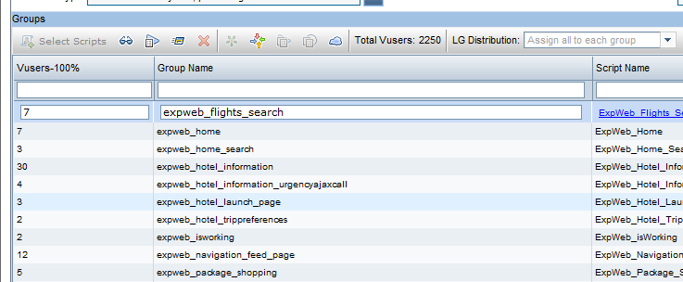
Web Interface

Slide 33
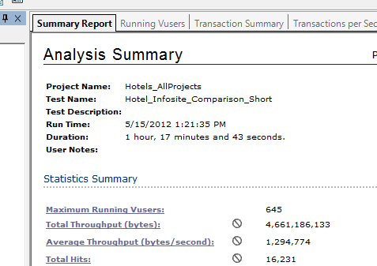
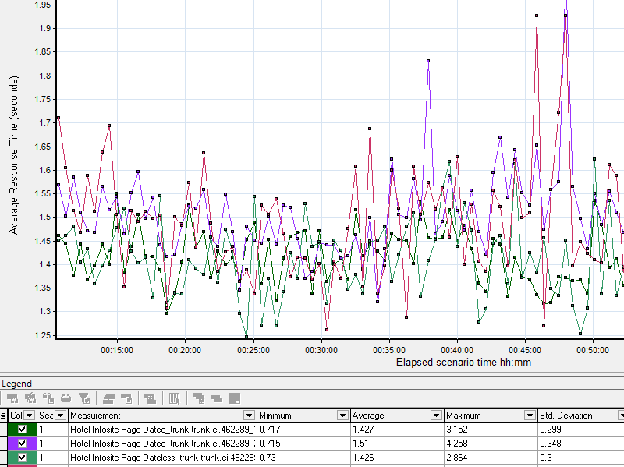
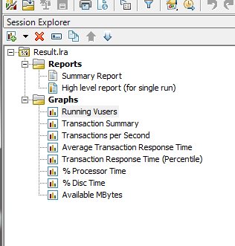
Analysis

Slide 34
Advantages of Performance Center
1. Environments
Multiple organizations inside the same company
Geographically dispersed teams (Global development)
Wide variety of technologies
Agile development
Continuous delivery (Weekly releases)
Pressure to reduce costs

Slide 35
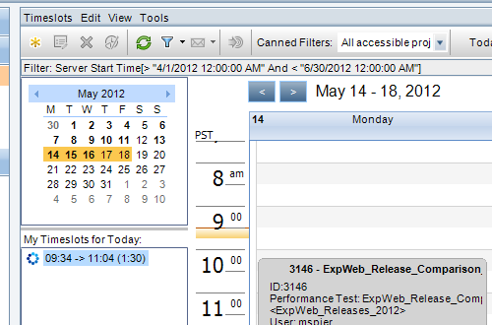
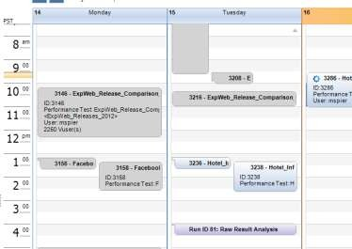
Efficient Use of Resources
How?
Sharing resources
Timeslot reservation enables resources to be shared without creating an environment management nightmare.
Resource pools and per project limits enable a fair share of resources to be distributed per team.

Slide 36
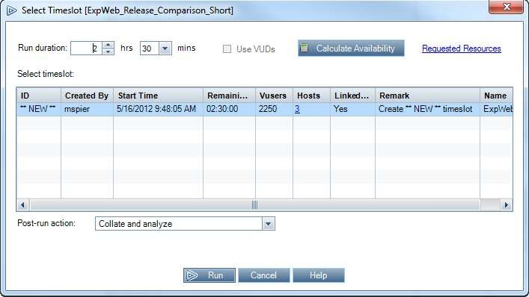
Efficient Use of Resources
How?
Test scheduling
The ability of scheduling tests to execute in the future enable teams to use the precious resources even when no one is around
24/7 test coverage

Slide 37
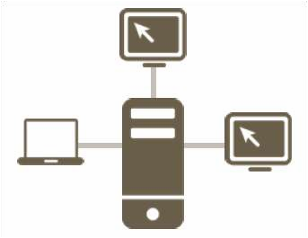
Efficient Use of Resources
How?
Leveraging software licenses
License costs would be higher if each team had their own set of controller and virtual user licenses
There is only one global limit for virtual users.
Simple math, 26 independent teams would use 26 controller licenses.
Sharing resources enables teams to do the same thing, using less than half licenses for concurrent runs, just by reducing idle time. That’s economy of scale.

Slide 38
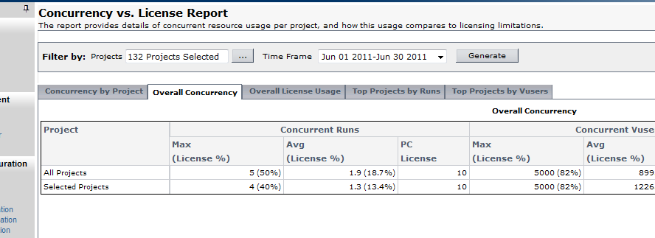
Efficient Use of Resources
How?
Better capacity planning
Centralized resource usage metrics serve as a great tool for capacity planning

Slide 39
Distributed Testing Capabilities
Why?
Limited number of performance engineers
Increasing number of requests for early and frequent performance tests
Test earlier in the process
Execute small and more specialized tests

Slide 40
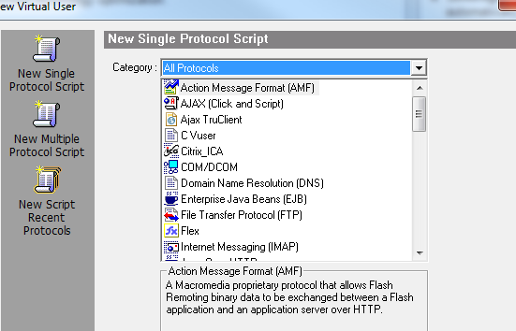
Distributed Testing Capabilities
How?
Enabling non-performance engineering teams to participate
Support for a wide variety of protocols enable specialized tests such as database specific, web services, etc
A simple web interface enables non- performance egineering teams to execute and analyze simple tests

Slide 41
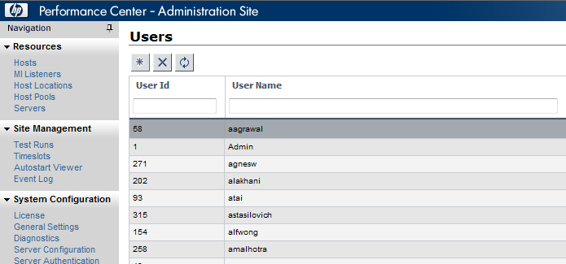
Administration?
How?
Single load test tool
Central administration makes it easy to add new users, create new projects and set up new resource pools.
Integration with LDAP/AD avoids the hassle of remembering another password.
Flexibility and support for a wide variety of protocols and and systems enabled Performance Center to be a single solution capable of attending requirements from all teams.
Less than ½ FTE is necessary to support the tool.

Slide 42
Re-Use Test Artifacts
Why?
Be more productive
Spend less time on recurring tasks

Slide 43
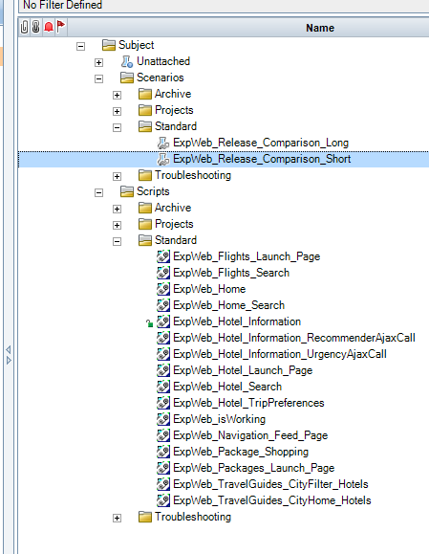

Re-Use Test Artifacts
How?
A Central Repository for Test Artifacts
A central repository for scripts and scenarios with version control makes it easy to find and reuse test artifacts
A single location for results and reports helps
keeping track and comparing executions

Slide 44
Typical Load Testing results
Test Date | 07/23/2018
Test Start Time | 10:17:12 AM
Test End Time | 10:46:45 AM
Test Duration | 29 Minutes and 33 Seconds
Maximum Running Vusers: | 300
Total Vusers | 300
Total Throughput (bytes): | 2,496,746,560
Total Hits: | 54,984
Total Number of Transactions: | 54,983
. Summary:

Slide 45
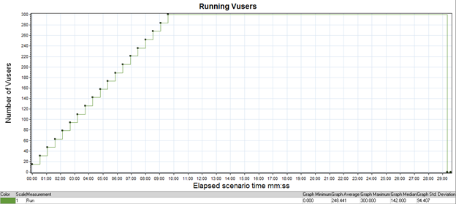
Concurrency
Concurrency: in this test we achieved the maximum concurrency of 300 users.

Slide 46
Transaction Summary
 | 7/23/2018 10:17:12 AM-10:46:45 AM 29 min and 33 Sec 300 Users
Transaction Name | Avg | Std. Dev | 90 Per | Pass | Fail
CAPD_completed_FlowsheetSearch | 0.084 | 0.038 | 0.11 | 7,410 | 0
CCPD_Completed_Flowsheet_Search | 0.079 | 0.071 | 0.1 | 7,322 | 0
ClinicalServices_Encounter | 0.028 | 0.014 | 0.037 | 7,439 | 0
Clinicalservices_LabResults | 0.18 | 0.1 | 0.244 | 7,242 | 0
Clinicalservices_MedicationOrder | 0.019 | 0.013 | 0.029 | 7,440 | 0
Clinicalservices_MedicationStatement | 0.126 | 0.079 | 0.187 | 7,347 | 0
ClinicalServices_PatientSearch | 0.017 | 0.094 | 0.011 | 7,456 | 0
Clinicalservices_VitalStatement | 0.124 | 0.098 | 0.18 | 3,327 | 0

Slide 47
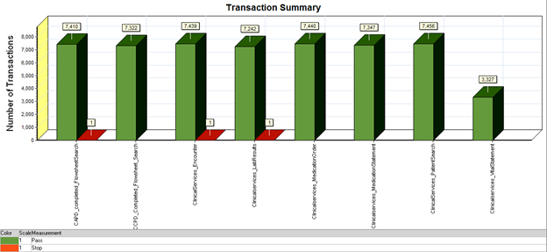
Transaction Summary

Slide 48
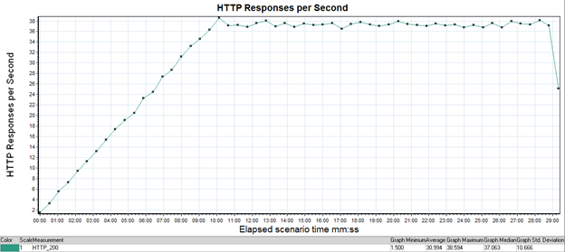
HTTP Response

Slide 49
Top 15 BEST Performance Testing Tools
WebLOAD
LoadUI NG Pro
SmartMeter.io
LoadView
Apache JMeter
LoadRunner (Performance Center)
Appvance
NeoLoad
LoadComplete
Loadster
LoadImpact
Rational Performance Tester
Testing Anywhere
OpenSTA
QEngine (ManageEngine)
Loadstorm
CloudTest
Httperf
WAPT
https://www.softwaretestinghelp.com/performance-testing-tools-load-testing-tools/

Slide 50
References:
https://msdn.microsoft.com/en-us/library/bb924356.aspx
http://www.gallop.net/blog/2-classic-cases-where-performance-testing-failures-plague-large-organisations/
http://www.techrepublic.com/article/outages-on-facebook-linkedin-paypal-and-other-sites-might-point-to-bgp-failures/
https://blogs.akamai.com/2015/06/performance-matters-more-than-ever.html
https://blog.kissmetrics.com/loading-time/

Slide 51
References:
https://www.dynatrace.com/blog/key-performance-metrics-load-tests-beyond-response-time-part/

Slide 52

Software Monitoring
Software Monitoring Types:
Application Monitoring
Network Monitoring
Performance Monitoring
And more…(Performance Monitoring, DB Monitoring and etc..)

Slide 53

What is Application Monitoring?
Application monitoring is a process that ensures that a software application processes and performs in an expected manner and scope.
Also known as Application Performance Monitoring (APM)
An ‘Alert’ is sent to the particular distribution groups upon detecting any unexpected errors or abnormalities.

Slide 54

What is Application Monitoring?
This technique routinely identifies, measures and evaluates the performance of an application and provides the means to isolate and rectify any abnormalities.
Dedicated teams monitor and receive alerts based on criteria set in the monitoring tool.
Based on the alerts, processes are followed to address the issue and restore the services.

Slide 55
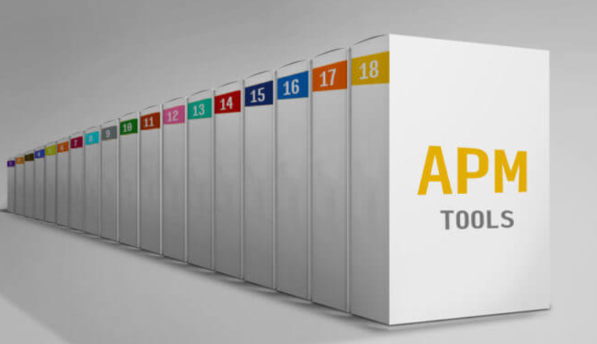
Application Monitoring Tools
App Dynamics
Splunk
Amazon CloudWatch
Solarwinds
New Relic APM
Coradiant
Riverbed SteelCentral
Dell Foglight
IDERA Precise
Nastel
https://www.imobdevtech.com/Blog/list-of-top-10-application-performance-monitoring-tools/

Slide 56
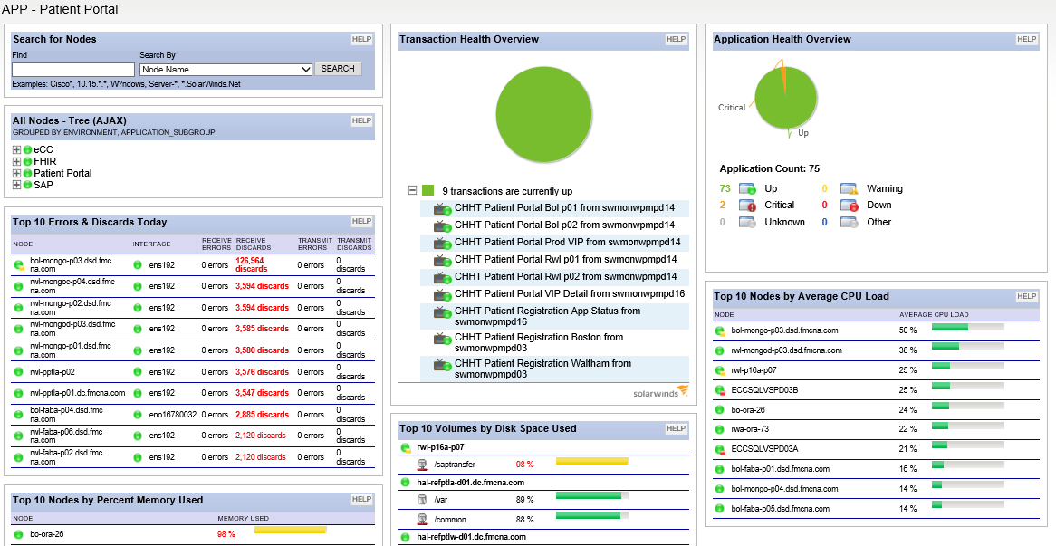
Solarwinds Dashboard

Slide 57
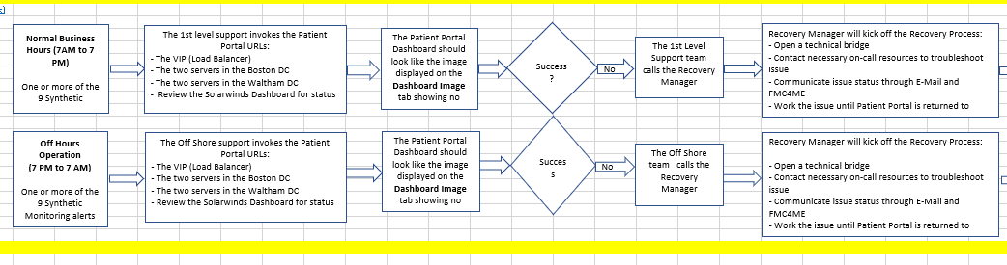
Application Monitoring Process Flow

Slide 58
Questions?

